Slide 1
CSE 111 Project: Pokedex
By Hunter brown and hridaya patel

Slide 2
Application description
Our Application is a simple Pokedex
Can Look up general information on Pokemon, look up data on Pokemon you own, and edit data on Pokemon your characters own
Inspired to do this project due to the release of Pokemon Go

Slide 3
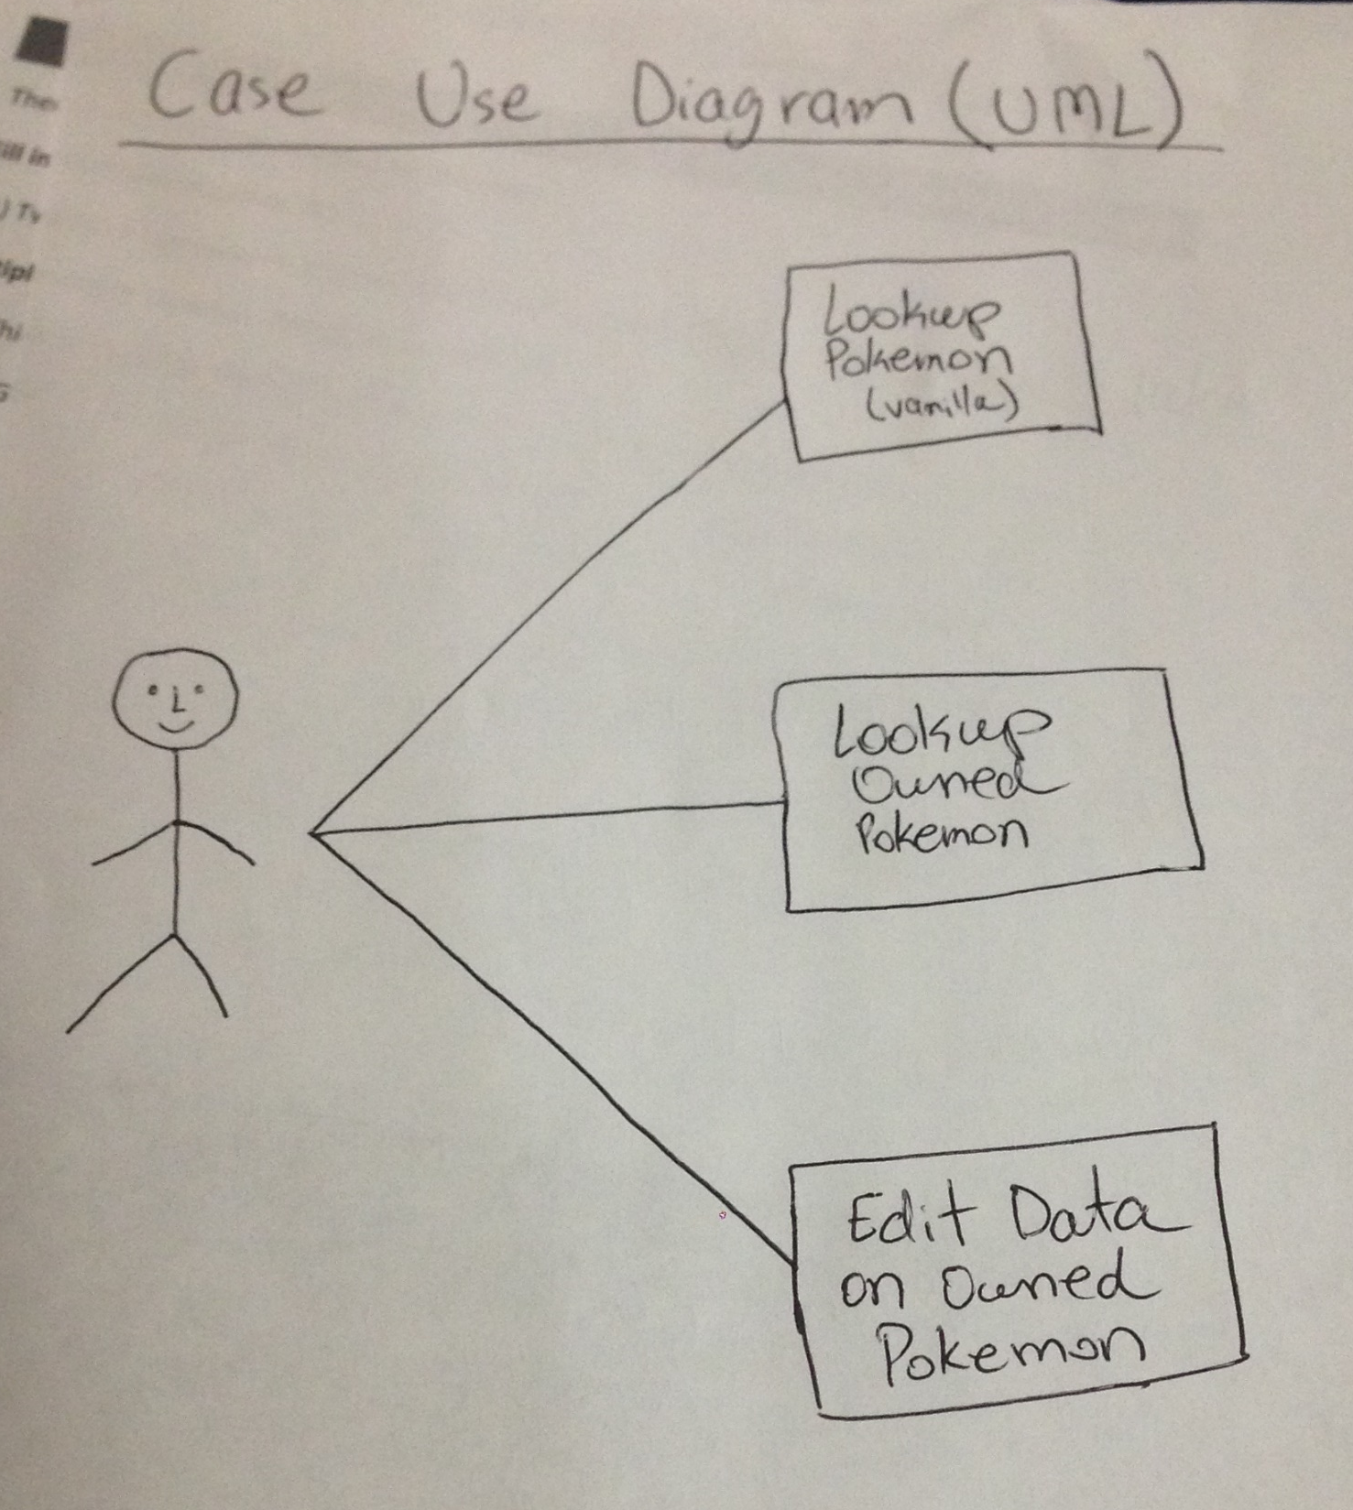
Use-Case Diagram

Slide 4
e/r diagram
On next slide
10 Tables

Slide 5
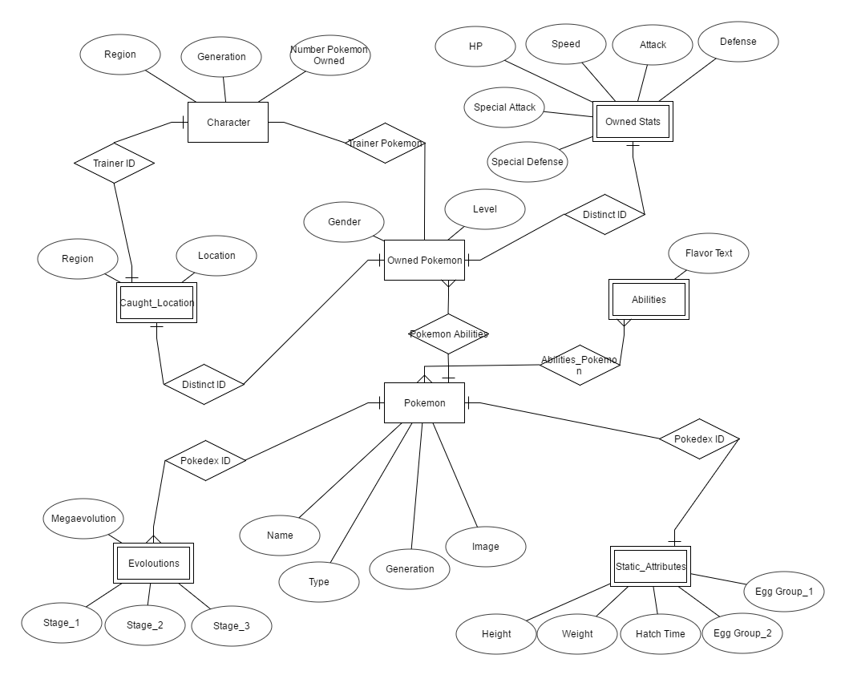

Slide 6
schema
Pokemon (Pokedex ID, name, image, type, Generation)
Pokemon_Abilities (Pokedex ID, Ability ID)
Owned_Pokemon (Distinct ID, Trainer ID, Pokedex ID, Gender, Level, Ability ID)
Owned_Stats (Distinct ID, HP, Speed, Attack, Defense, Special Attack, Special Defense)
Static_Attributes (Pokedex ID, Height, Weight, Hatch Time, Egg Group 1, Egg Group 2)
Evolutions (Pokedex ID, stage 1, stage 2, stage 3, Megaevolution)
Character (Trainer ID, Region, Generation, Number Pokemon Owned)
Caught_Location (Distinct ID, Trainer ID, Region, Location)
Ability (Ability ID, Ability Name, Flavor Text)
Trainer_Pokemon (Distinct ID, Trainer ID)

Slide 7
Implementation details
Database: SQLite
Implementation Language: Java using JDBC
Command Line Interface
Editor: Eclipse
Data is pulled from Bulbapedia

Slide 8
Demo

Slide 9
Any questions?

